Slide 1
Introduction

Slide 2
Lesson Objectives
After completing this lesson, you should be able to do the following:
  Discuss the goals of the course
  Describe the database schema and tables that are used in the course
  Identify the available environments that can be used in the course
  Review some of the basic concepts of SQL
Notes:
Oracle Database 11g: SQL Fundamentals II I - <number>

Slide 3
Lesson Agenda
  Course objectives and course agenda
  The database schema and appendixes used in the course and the available development environment in this course
  Review of some basic concepts of SQL
  Oracle Database 11g documentation and additional resources

Slide 4
Course Objectives
After completing this course, you should be able to do the following:
  Control database access to specific objects
  Add new users with different levels of access privileges
  Manage schema objects
  Manage objects with data dictionary views
  Manipulate large data sets in the Oracle database by using subqueries
  Manage data in different time zones
  Write multiple-column subqueries
  Use scalar and correlated subqueries
  Use the regular expression support in SQL
Notes:
Oracle Database 11g: SQL Fundamentals II I - <number>

Slide 5
Course Prerequisites
The Oracle Database 11g: SQL Fundamentals I course is a prerequisite for this course.
Notes:
Course Prerequisites
Required preparation for this course is Oracle Database 11g: SQL Fundamentals I.
This course offers you an introduction to Oracle Database 11g database technology. In this course, you learn the basic concepts of relational databases and the powerful SQL programming language. This course provides the essential SQL skills that enable you to write queries against single and multiple tables, manipulate data in tables, create database objects, and query metadata.

Slide 6
Course Agenda
  Day 1:
    Introduction
    Controlling User Access
    Managing Schema Objects
    Managing Objects with Data Dictionary Views
  Day 2:
    Manipulating Large Data Sets
    Managing Data in Different Time Zones
    Retrieving Data by Using Subqueries
    Regular Expression Support
Notes:
Oracle Database 11g: SQL Fundamentals II I - <number>

Slide 7
Lesson Agenda
  Course objectives and course agenda
  The database schema and appendixes used in the course and the available development environment in this course
  Review of some basic concepts of SQL
  Oracle Database 11g documentation and additional resources

Slide 8
Tables Used in This Course
DEPARTMENTS
department_id
department_name
manager_id
location_id
LOCATIONS
location_id
street_address
postal_code
city
state_province
country_id
JOB_HISTORY
employee_id
start_date
end_date
job_id
department_id
EMPLOYEES
employee_id
first_name
last_name
email
phone_number
hire_date
job_id
salary
commission_pct
manager_id
department_id
COUNTRIES
country_id
country_name
region_id
JOBS
job_id
job_title
min_salary
max_salary
REGIONS
region_id
region_name
JOB_GRADES
grade_level
lowest_sal
highest_sal
Notes:
Table Description
This course uses data from the following tables:
Table Descriptions
The EMPLOYEES table contains information about all the employees, such as their first and last names, job IDs, salaries, hire dates, department IDs, and manager IDs. This table is a child of the DEPARTMENTS table.
The DEPARTMENTS table contains information such as the department ID, department name, manager ID, and location ID. This table is the primary key table to the EMPLOYEES table.
The LOCATIONS table contains department location information. It contains location ID, street address, city, state province, postal code, and country ID information. It is the primary key table to the DEPARTMENTS table and is a child of the COUNTRIES table.
The COUNTRIES table contains the country names, country IDs, and region IDs. It is a child of the REGIONS table. This table is the primary key table to the LOCATIONS table.
The REGIONS table contains region IDs and region names of the various countries. It is a primary key table to the COUNTRIES table.
The JOB_GRADES table identifies a salary range per job grade. The salary ranges do not overlap.
The JOB_HISTORY table stores job history of the employees.
The JOBS table contains job titles and salary ranges.

Slide 9
Appendixes Used in This Course
  Appendix A: Practices and Solutions
  Appendix B: Table Descriptions
  Appendix C: Using SQL Developer
  Appendix D: Using SQL*Plus
  Appendix E: Using JDeveloper
  Appendix F: Generating Reports by Grouping Related Data
  Appendix G: Hierarchical Retrieval
  Appendix H: Writing Advanced Scripts
  Appendix I: Oracle Database Architectural Components

Slide 10
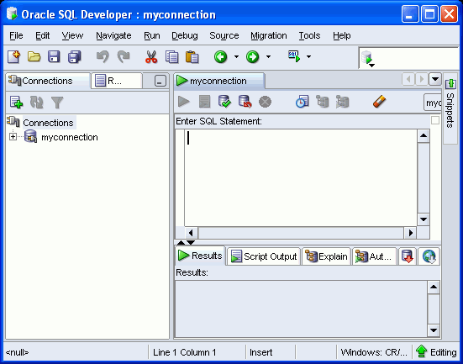
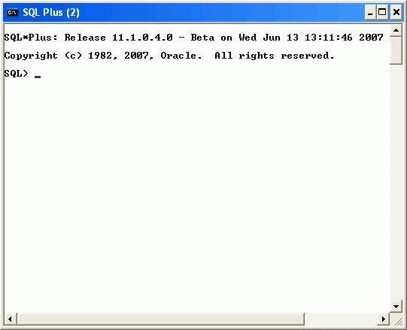
Development Environments
There are two development environments for this course:
  The primary tool is Oracle SQL Developer.
  You can also use SQL*Plus command-line interface.
SQL Developer
SQL *Plus
Notes:
Oracle Database 11g: SQL Fundamentals II I - <number>
Development Environments
SQL Developer
This course has been developed using Oracle SQL Developer as the tool for running the SQL statements discussed in the examples in the slide and the practices.
SQL Developer version 1.5.4 is shipped with Oracle Database 11g Release 2, and is the default tool for this class.
In addition, SQL Developer version 1.5.4 is also available on the classroom machine, and may be installed for use. At the time of publication of this course, version 1.5.3 was the latest release of SQL Developer.
SQL*Plus
The SQL*Plus environment may also be used to run all SQL commands covered in this course.
Note
See Appendix C titled “Using SQL Developer” for information about using SQL Developer, including simple instructions on installing version 1.5.4.
See Appendix D titled “Using SQL*Plus” for information about using SQL*Plus.

Slide 11
Lesson Agenda
  Course objectives and course agenda
  The database schema and appendixes used in the course and the available development environment in this course
  Review of some basic concepts of SQL
  Oracle Database 11g documentation and additional resources
Notes:
Lesson Agenda
The next few slides provide a brief overview of some of the basic concepts that you learned in the course titled Oracle Database 11g: SQL Fundamentals I.

Slide 12
Review of Restricting Data
  Restrict the rows that are returned by using the WHERE clause.
  Use comparison conditions to compare one expression with another value or expression.
  Use logical conditions to combine the result of two component conditions and produce a single result based on those conditions.
Operator | Meaning
BETWEEN ...AND... | Between two values (inclusive)
IN(set) | Match any of a list of values
LIKE | Match a character pattern
Notes:
Review of Restricting Data
You can restrict the rows that are returned from the query by using the WHERE clause. A WHERE clause contains a condition that must be met, and it directly follows the FROM clause.
The WHERE clause can compare values in columns, literal values, arithmetic expression, or functions. It consists of three elements:
Column name
Comparison condition
Column name, constant, or list of values
You use comparison conditions in the WHERE clause in the following format:
... WHERE expr operator value
Apart from those mentioned in the slide, you use other comparison conditions such as =, <, >, <>, <=, and >=.
Three logical operators are available in SQL:
AND
OR
NOT

Slide 13
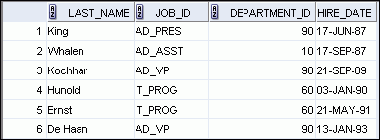
Review of Sorting Data
  Sort retrieved rows with the ORDER BY clause:
    ASC: Ascending order, default
    DESC: Descending order
  The ORDER BY clause comes last in the SELECT statement:
SELECT last_name, job_id, department_id, hire_date
FROM employees
ORDER BY hire_date ;
…
Notes:
Review of Sorting Data
The order of rows that are returned in a query result is undefined. The ORDER BY clause can be used to sort the rows. If you use the ORDER BY clause, it must be the last clause of the SQL statement. You can specify an expression, an alias, or a column position as the sort condition.
Syntax
SELECT expr
FROM table
[WHERE condition(s)]
[ORDER BY {column, expr, numeric_position} [ASC|DESC]];
In the syntax:
ORDER BY Specifies the order in which the retrieved rows are displayed
ASC Orders the rows in ascending order (This is the default order.)
DESC Orders the rows in descending order
If the ORDER BY clause is not used, the sort order is undefined, and the Oracle server may not fetch rows in the same order for the same query twice. Use the ORDER BY clause to display the rows in a specific order.

Slide 14
Review of SQL Functions
Functions
Single-row
functions
Multiple-row
functions
Return one result
per row
Return one result
per set of rows
Notes:
Review of SQL Functions
There are two types of functions:
Single-row functions
Multiple-row functions
Single-Row Functions
These functions operate on single rows only and return one result per row. There are different types of single-row functions such as character, number, date, conversion, and general functions.
Multiple-Row Functions
Functions can manipulate groups of rows to give one result per group of rows. These functions are also known as group functions.

Slide 15
Review of Single-Row Functions
Character
General
Single-row
functions
Number
Conversion
Date
Notes:
Review of Single-Row Functions
The following are different types of single-row functions:
Character functions: Αccept character input and can return both character and number values
Number functions: Accept numeric input and return numeric values
Date functions: Operate on values of the DATE data type (All date functions return a value of the DATE data type, except the MONTHS_BETWEEN function, which returns a number.)
Conversion functions: Convert a value from one data type to another
General functions:
NVL
NVL2
NULLIF
COALESCE
CASE
DECODE

Slide 16
Review of Types of Group Functions
  AVG
  COUNT
  MAX
  MIN
  STDDEV
  SUM
  VARIANCE
Group
functions
Notes:
Review of Types of Group Functions
Each of the functions accepts an argument. The following table identifies the options that you can use in the syntax:

Slide 17
Review of Using Subqueries
  A subquery is a SELECT statement nested in a clause of another SELECT statement.
  Syntax:
  Types of subqueries:
SELECT select_list
FROM table
WHERE expr operator
(SELECT select_list
FROM table );
Single-row subquery | Multiple-row subquery
Returns only one row | Returns more than one row
Uses single-row comparison operators | Uses multiple-row comparison operators
Notes:
Review of Using Subqueries
You can build powerful statements out of simple ones by using subqueries. Subqueries are useful when a query is based on a search criterion with unknown intermediate values.
You can place the subquery in a number of SQL clauses, including the following:
WHERE clause
HAVING clause
FROM clause
The subquery (inner query) executes once before the main query (outer query). The result of the subquery is used by the main query.
A single-row subquery uses a single-row operator such as =, >, <, >=, <=, and <>. With a multiple-row subquery, you use a multiple-row operator such as IN, ANY, and ALL.
Example: Display details of employees whose salary is equal to the minimum salary.
SELECT last_name, salary, job_id
FROM employees
WHERE salary = (SELECT MIN(salary)
FROM employees );
In the example, the MIN group function returns a single value to the outer query.
Note: In this course, you learn how to use multiple-column subqueries. Multiple-column subqueries return more than one column from the inner SELECT statement.

Slide 18
Review of Manipulating Data
A data manipulation language (DML) statement is executed when you:
  Add new rows to a table
  Modify existing rows in a table
  Remove existing rows from a table
Function | Description
INSERT | Adds a new row to the table
UPDATE | Modifies existing rows in the table
DELETE | Removes existing rows from the table
MERGE | Updates, inserts, or deletes a row conditionally into/from a table
Notes:
Review of Manipulating Data
When you want to add, update, or delete data in the database, you execute a DML statement. A collection of DML statements that form a logical unit of work is called a transaction. You can add new rows to a table by using the INSERT statement. With the following syntax, only one row is inserted at a time.
INSERT INTO table [(column [, column…])]
VALUES (value[, value...]);
You can use the INSERT statement to add rows to a table where the values are derived from existing tables. In place of the VALUES clause, you use a subquery. The number of columns and their data types in the column list of the INSERT clause must match the number of values and their data types in the subquery.
The UPDATE statement modifies specific rows if you specify the WHERE clause.
UPDATE table
SET column = value [, column = value, ...]
[WHERE condition];
You can remove existing rows by using the DELETE statement. You can delete specific rows by specifying the WHERE clause in the DELETE statement.
DELETE [FROM] table
[WHERE condition];
You learn about the MERGE statement in the lesson titled “Manipulating Large Data Sets.”

Slide 19
Lesson Agenda
  Course objectives and course agenda
  The database schema and appendixes used in the course and the available development environment in this course
  Review of some basic concepts of SQL
  Oracle Database 11g documentation and additional resources

Slide 20
Oracle Database 11g SQL Documentation
  Oracle Database New Features Guide 11g Release 2 (11.2)
  Oracle Database Reference 11g Release 2 (11.2)
  Oracle Database SQL Language Reference 11g Release 2 (11.2)
  Oracle Database Concepts 11g Release 2 (11.2)
  Oracle Database SQL Developer User’s Guide Release 1.2
Notes:
Oracle Database 11g SQL Documentation
Navigate to http://www.oracle.com/pls/db112/homepage to access the Oracle Database 11g Release 2 documentation library.

Slide 21
Additional Resources
For additional information about the new Oracle 11g SQL, refer to the following:
  Oracle Database 11g: New Features eStudies
  Oracle by Example series (OBE): Oracle Database 11g

Slide 22
Summary
In this lesson, you should have learned the following:
  The course objectives
  The sample tables used in the course
Notes:
Oracle Database 11g: SQL Fundamentals II I - <number>

Slide 23
Practice I: Overview
This practice covers the following topics:
  Running the SQL Developer online tutorial
  Starting SQL Developer and creating a new database connection and browsing the tables
  Executing SQL statements using the SQL Worksheet
  Reviewing the basic concepts of SQL
Notes:
Practice I: Overview
In this practice, you use SQL Developer to execute SQL statements.
Note: All written practices use SQL Developer as the development environment. Although it is recommended that you use SQL Developer, you can also use the SQL*Plus environment that is available in this course.

